Slide 1
Task 1
Qgood solution

Slide 2
Problem formulation
Find such vector x_{ijklm} that it satisfies all listed constraints.
Here indices are:
i – for teacher
j – for subject
k – for group
l – for day
m – for hour

Slide 3
Problem formulation
We can eliminate j in our case, since it can be classically filled.

Slide 4
Complexity of QUBO estimation
Let it be T=W*D*H time slots
N teachers and M=S*N subjects, each tutor teach S
K groups
No more than F equal subjects in one day
No more than G lessons in one day
No more than E hours for teacher in a week
T*K*M binary variables. Additionally:
K*W*D*G variables for max lesson in a day constraint
S*N*W*D*K*F variables for max equal lesson in a day constraint
W*N*E variables for teacher worktime constraint
=> O(TKM + KWDG + MWDKF + WNE) binary variables and O((TKM + KWDG + MWDKF + WNE)²) space/time complexity

Slide 5
Time complexity of QUBO formulation
One subject at one time -> O(T*K*(M)²)
One lesson for teacher -> O(T*N*(S*K)²)
Max lectures in one day -> O(W*D*K*(G²+(G+M*H)²))
Max similar lessons -> O(W*D*K*M*(F²+(H+F)²))
Right amount of lectures -> O(K*M*T²)
Teachers workdays -> O(N*(S*T)⁽²⁾)

Slide 6
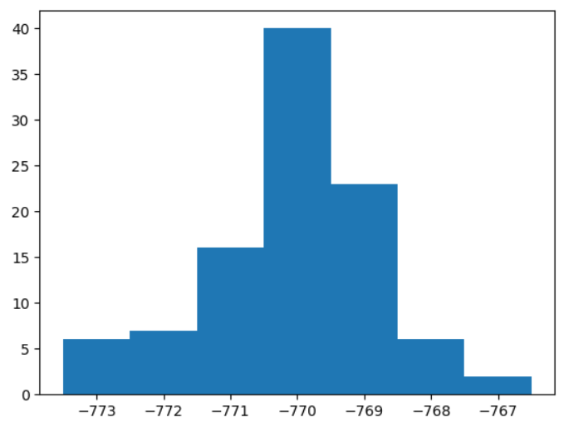
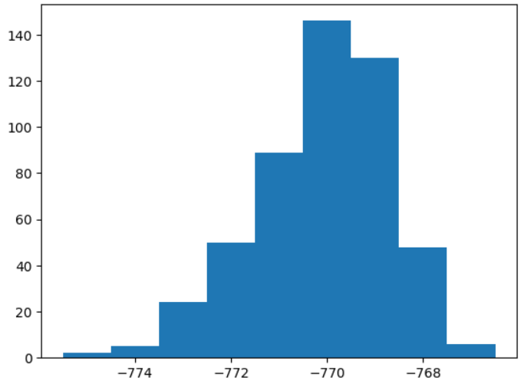
Conclusions
Only polynomial amount of time/space is required

Slide 7
Classical approaches
Annealing Simulation (exactly what we do)
Evolution algorithms
Artificial intelligence

